Slide 1
UNIT – 3
Discrete Distributions

Slide 2
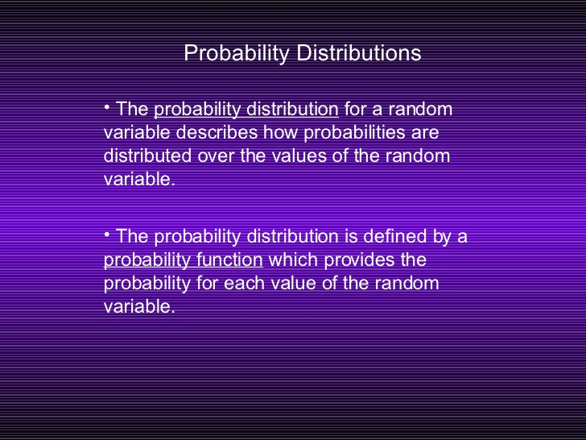

Slide 3
Probability distribution
Probability distributions can be shown in tables and graphs or they can also be described by a formula.

Slide 4

Probability distribution
The following table shows the probability distribution of a tomato packing plant receiving rotten tomatoes.
Note that if you add all of the probabilities in the second row, they add up to 1 (.95 + .02 +.02 +0.01 = 1).

Slide 5
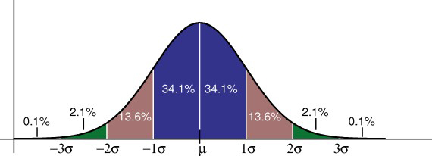
Probability distribution
The following graph shows a standard normal distribution, which is probably the most widely used probability distribution.
The normal curve is a continuous probability distribution, so instead of adding up individual probabilities under the curve we say that the total area under the curve is 1.
Note that if you add all of the probabilities in the second row, they add up to 1 (.95 + .02 +.02 +0.01 = 1).

Slide 6
Probability distribution
continuous probability distributions
or
discrete probability distributions
Depending on whether they define probabilities for continuous or discrete variables.

Slide 7
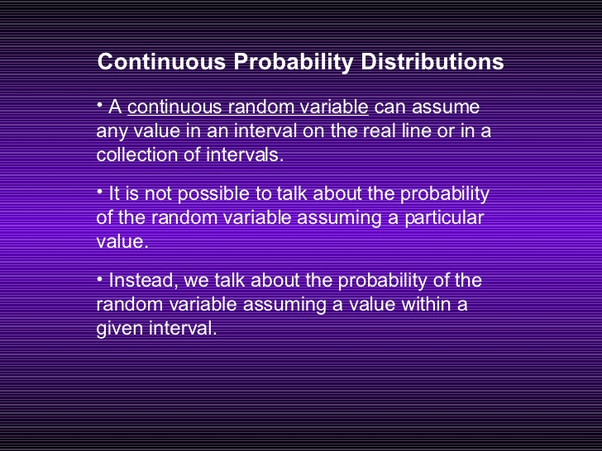
Sample selection

Slide 8
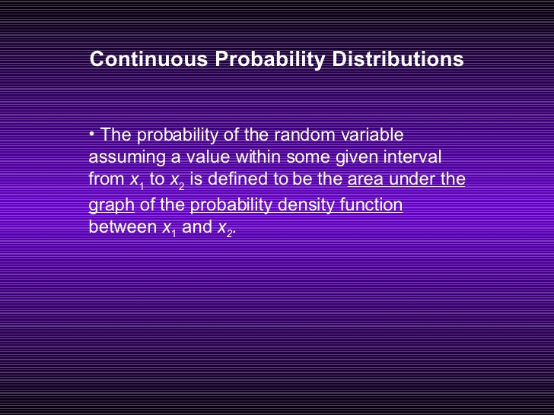
Notes:
Figure 1.1
The relationship between a population and a sample.

Slide 9
Discrete distribution
A discrete distribution describes the probability of occurrence of each value of a discrete random variable.
A discrete random variable is a random variable that has countable values
Each possible value of the discrete random variable can be associated with a non-zero probability.
Thus, a discrete probability distribution is often presented in tabular form.

Slide 10

Bernoulli Distribution
named after the swiss mathematician Jacques Bernoulli (1654– 1705).
The easiest distribution is the Bernoulli distribution.
A Bernoulli distribution has only two possible outcomes, namely 1 (success) and 0 (failure), and a single trial.
So the random variable X which has a Bernoulli distribution can take value 1 with the probability of success, say p, and the value 0 with the probability of failure, say q or 1-p.

Slide 11
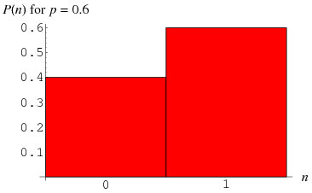
Bernoulli Distribution
In the case of coin toss, the occurrence of a head denotes success, and the occurrence of a tail denotes failure. Probability of getting a head = 0.6 and the Probability of getting a tail =0.4 since there are only two possible outcomes.

Slide 12
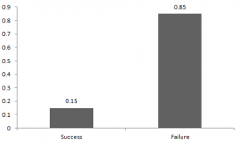
Bernoulli Distribution
The probabilities of success and failure need not be equally likely, like the rainfall prediction. So in this case probability of rain is 0.15 while no rain is 0.85. Here, the probability of success(p) is not same as the probability of failure. So, the chart below shows the Bernoulli distribution of rain.

Slide 13
Bernoulli Distribution
The expected value of a random variable X from a Bernoulli distribution is found as follows:
  E(X) = 1*p + 0*(1-p) = p
The variance of a random variable from a bernoulli distribution is:
  V(X) = E(X²) – [E(X)]² = p – p² = p(1-p)

Slide 14
Binomial Distribution
A binomial experiment is a statistical experiment that has the following properties:
The experiment consists of n repeated trials.
Each trial can result in just two possible outcomes. We call one of these outcomes a success and the other, a failure.
The probability of success, denoted by P, is the same on every trial.
The trials are independent; that is, the outcome on one trial does not affect the outcome on other trials.
Ex: Flip a coin for n times and count the number of times the coin lands on heads.

Slide 15
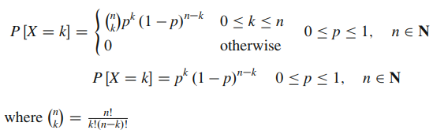
Binomial Distribution
A binomial distribution can be thought of as simply the probability of a SUCCESS or FAILURE (gain or loss, win or lose) outcome in an experiment or survey that is repeated multiple times where the probability of success and failure is same for all the trials is called a Binomial Distribution.
The mathematical representation of binomial distribution is given by:

Slide 16
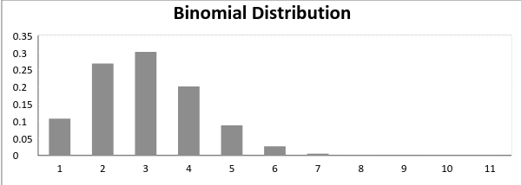
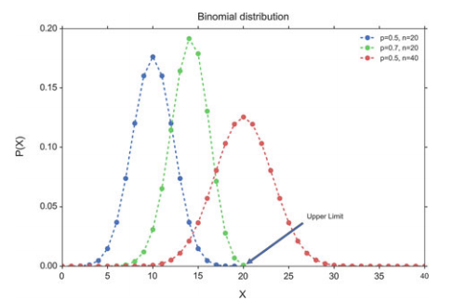
Binomial Distribution

Slide 17

Binomial Distribution
If a coin is tossed 4 times following are the probabilities of getting 0 to 4 heads are:
[0.0625, 0.25 , 0.375, 0.25 , 0.0625 ]
That means, the chance that heads never comes up is about 6 %, the chance that it comes up exactly once is 25 %, etc
Also note that the sum of all probabilities has to add up exactly to one:
The mean and variance of a binomial distribution are given by:
Mean = µ = n*p
Variance = Var(X) = n*p*q

Slide 18
Binomial Distribution
Some example questions that are modeled with a binomial distribution are:
• Out of ten tosses, how many times will this coin land heads?
• From the children born in a given hospital on a given day, how many of them will be girls?
• How many students in a given classroom will have green eyes?
• How many mosquitoes, out of a swarm, will die when sprayed with insecticide?

Slide 19
Binomial Distribution
A coin is tossed 10 times. What is the probability of getting exactly 6 heads?
The number of trials (n) is 10
The odds of success (“tossing a heads”) is 0.5 (So 1-p = 0.5) i.e. x = 6
P(x=6) = ₁₀C₆ * 0.5^6 * 0.5^4 = 210 * 0.015625 * 0.0625 = 0.205078125

Slide 20
Binomial Distribution
Suppose a die is tossed 5 times. What is the probability of getting exactly 2 fours?
Solution: This is a binomial experiment in which the number of trials is equal to 5, the number of successes is equal to 2, and the probability of success on a single trial is 1/6 or about 0.167. Therefore, the binomial probability is:
b(2; 5, 0.167) = ₅C₂ * (0.167)² * (0.833)³
b(2; 5, 0.167) = 0.161

Slide 21
Poisson Distribution:
In French “Poisson” means “fish,” but the name comes from the mathematician Siméon-Denis Poisson (1781–1840).
The Poisson distribution is very similar to the binomial distribution.
Whereas the binomial distribution looks at how many times we register a success over a fixed total number of trials, the Poisson distribution measures how many times a discrete event occurs, over a period of continuous space or time.
There is no “total” value n, and the Poisson distribution is defined by a single parameter.

Slide 22
Poisson Distribution:
The following questions can be answered with the Poisson distribution:
• How many pennies will I encounter on my walk home?
• How many children will be delivered at the hospital today?
• How many products will I sell after airing a new television commercial?
• How many mosquito bites did you get today after having sprayed with insecticide?
• How many defects will there be per 100 m of rope sold?

Slide 23

Poisson Distribution:
Poisson distribution is described in terms of the rate (μ) at which the events happen. An event can occur 0, 1, 2, … times in an interval.
The average number of events in an interval is designated λ (lambda). Lambda is the event rate, also called the rate parameter.
The probability of observing k events in an interval is given by the equation:

Slide 24
Poisson Distribution:
Example 1:
The mean value for an event X to occur is 2 in a day. Find the probability of event X to occur thrice in a day.

Slide 25

Poisson Distribution:
Example 1:
The mean value for an event X to occur is 2 in a day. Find the probability of event X to occur thrice in a day.
Solution:
Mean, m=2
Probability of the event to occur thrice, P(3;2)

Slide 26
Poisson Distribution:
Problem: A shop sells five pieces of shirt everyday, then what is the probability of selling three shirts today?
Solution:
Mean value for 1 day, m=5

Slide 27
Poisson Distribution:
Problem: A shop sells five pieces of shirt everyday, then what is the probability of selling three shirts today?
Mean value for 1 day, m=5
Probability of selling 33 shirts, P(3;5)
P(3;5) = 0.007018690.00701869
Hence, the probability of selling three shirts is 0.007018690 when at the average 5 shirts are being sold each day.

Slide 28
Poisson Distribution:
Problem 2:
If three persons, on an average, come to ABC company for job interview, then find the probability that less than three people have come for interview on a given day.
Solution:
The mean for Poisson random variable, m=3

Slide 29
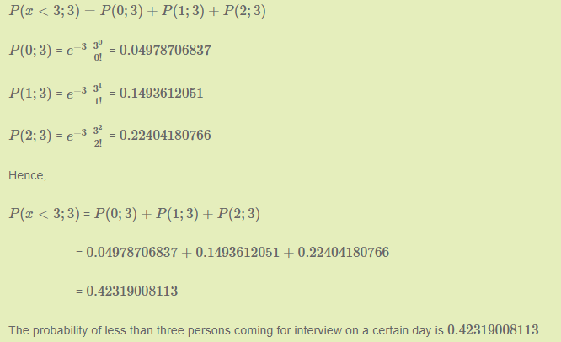
Poisson Distribution:

Slide 30
Binomial Distribution:
Example 1: A test is conducted which is consisting of 20 MCQs (multiple choices questions) with every MCQ having its four options out of which only one is correct. Determine the probability that a person undertaking that test has answered exactly 5 questions wrong.

Slide 31
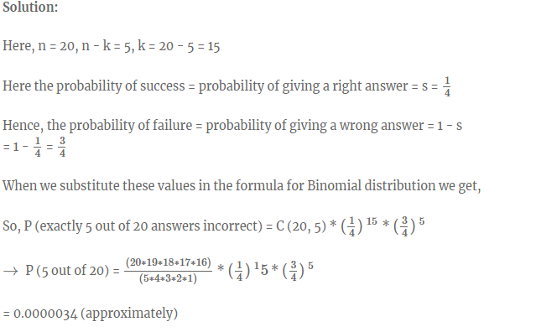
Binomial Distribution:

Slide 32
Binomial Distribution:
A die marked A to E is rolled 50 times. Find the probability of getting a “D” exactly 5 times.

Slide 33
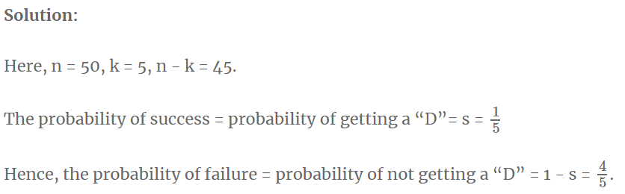
Binomial Distribution:

Slide 34
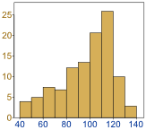
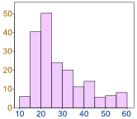
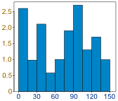
Normal Distribution:
Data can be "distributed" (spread out) in different ways.

Slide 35
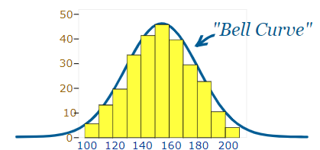
Normal Distribution:
The data tends to be around a central value with no bias left or right, and it called as a "Normal Distribution"

Slide 36

Normal Distribution:
It is often called a "Bell Curve" because it looks like a bell.
Mathematically, the normal distribution is characterized by a mean value µ, and a standard deviation, σ:
f(µ, σ) is the Probability Density Function (PDF) of the normal distribution

Slide 37
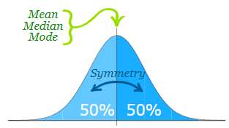
Normal Distribution:
The Normal Distribution has:
mean = median = mode
symmetry about the center
50% of values less than the mean and 50% greater than the mean

Slide 38
Normal Distribution:
Many things closely follow a Normal Distribution:
heights of people
size of things produced by machines
errors in measurements
blood pressure
marks on a test

Slide 39
Standard Deviations
The Standard Deviation is a measure of how spread out numbers are.
In a normal distribution when we calculate the standard deviation, we find that generally:
68% of values are within 1 standard deviation of the mean
95% of values are within 2 standard deviations of the mean
99.7% of values are within 3 standard deviations of the mean

Slide 40
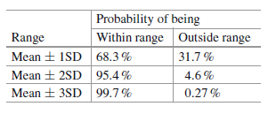
Normal Distribution
The Standard Deviation is a measure of how spread out numbers are.
In a normal distribution when we calculate the standard deviation, we find that generally:

Slide 41
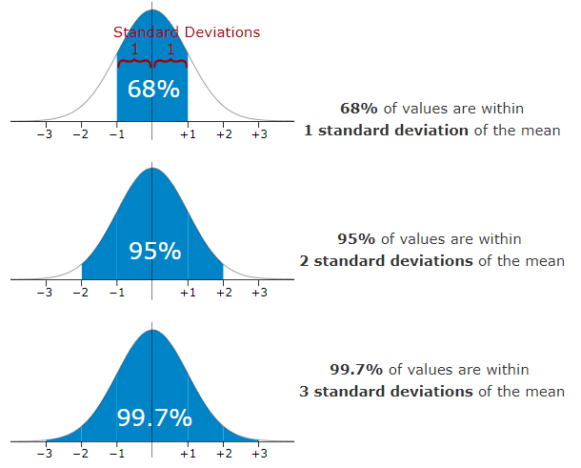
Normal Distribution

Slide 42
Normal Distribution
Problem: 95% of students at school are between 1.1m and 1.7m tall.
Assuming this data is normally distributed can you calculate the mean and standard deviation?

Slide 43
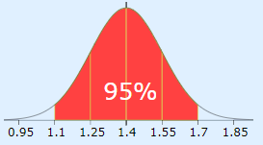
Normal Distribution
Problem: 95% of students at school are between 1.1m and 1.7m tall. Assuming this data is normally distributed can you calculate the mean and standard deviation?
The mean is halfway between 1.1m and 1.7m:
Mean = (1.1m + 1.7m) / 2 = 1.4m
95% is 2 standard deviations either side of the mean (a total of 4 standard deviations) so:
1 standard deviation = (1.7m-1.1m) / 4 = 0.6m / 4 = 0.15m

Slide 44
Standard Scores
The number of standard deviations from the mean
It is also called the "Standard Score", "sigma" or "z-score".

Slide 45
Standard Scores
Example: In that same school one of your friends is 1.85m tall. Find the z-score.
You can see on the bell curve that 1.85m is 3 standard deviations from the mean of 1.4, so:
Your friend's height has a "z-score" of 3.0
It is also possible to calculate how many standard deviations 1.85 is from the mean
How far is 1.85 from the mean?
It is 1.85 - 1.4 = 0.45m from the mean
How many standard deviations is that? The standard deviation is 0.15m, so:
0.45m / 0.15m = 3 standard deviations

Slide 46
Standard Scores
Example: In that same school one of your friends is 1.85m tall. Find the z-score.
You can see on the bell curve that 1.85m is 3 standard deviations from the mean of 1.4, so:
Your friend's height has a "z-score" of 3.0
It is also possible to calculate how many standard deviations 1.85 is from the mean
How far is 1.85 from the mean?
It is 1.85 - 1.4 = 0.45m from the mean
How many standard deviations is that? The standard deviation is 0.15m, so:
0.45m / 0.15m = 3 standard deviations

Slide 47

Standard normal distribution
So to convert a value to a Standard Score ("z-score"):
first subtract the mean,
then divide by the Standard Deviation
And doing that is called "Standardizing":
We can take any Normal Distribution and convert it to The Standard Normal Distribution.

Slide 48
Standard normal distribution
Here is the formula for z-score that we have been using:
z is the "z-score" (Standard Score)
x is the value to be standardized
μ is the mean
σ is the standard deviation

Slide 49
Standard normal distribution
Example: Travel Time. Convert the values to z-scores ("standard scores").
A survey of daily travel time had these results (in minutes):
26, 33, 65, 28, 34, 55, 25, 44, 50, 36, 26, 37, 43, 62, 35, 38, 45, 32, 28, 34
The Mean is 38.8 minutes, and the Standard Deviation is 11.4 minutes.
To convert 26:
first subtract the mean: 26 - 38.8 = -12.8,
then divide by the Standard Deviation: -12.8/11.4 = -1.12
So 26 is -1.12 Standard Deviations from the Mean

Slide 50
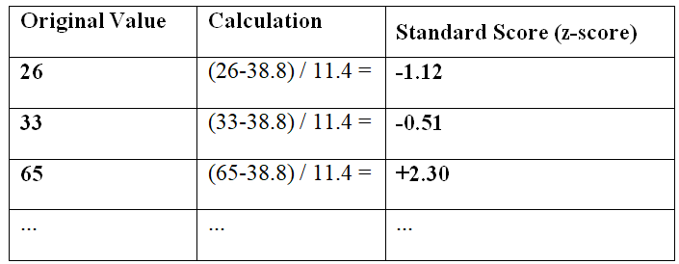
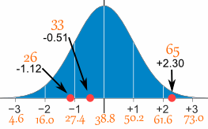
Standard normal distribution

Slide 51
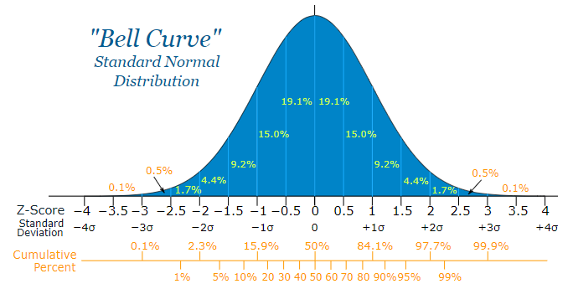
Standard normal distribution
Here is the Standard Normal Distribution with percentages for every half of a standard deviation, and cumulative percentages:

Slide 52
Standard normal distribution
Example: Your score in a recent test was 0.5 standard deviations above the average, how many people scored lower than you did?
Between 0 and 0.5 is 19.1%
Less than 0 is 50% (left half of the curve)
So the total less than you is: 50% + 19.1% = 69.1%
In theory 69.1% scored less than you did (but with real data the percentage may be different)

Slide 53
Python implementation - manipulations of normal distribution functions.
Example of how to calculate the interval of the PDF containing 95% of the data,
In [1]: import numpy as np
In [2]: from scipy import stats
In [3]: mu = -2
In [4]: sigma = 0.7
In [5]: myDistribution = stats.norm(mu, sigma)
In [6]: significanceLevel = 0.05
In [7]: myDistribution.ppf([significanceLevel/2, 1-significanceLevel/2] )
Out[8]: array([-3.38590382, -0.61409618]

Slide 54
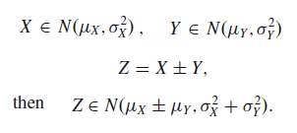
Sum of Normal Distributions
An important property of normal distributions is that the sum (or difference) of two normal distributions is also normally distributed. i.e., if
In words, the variance of the sum is the sum of the variances.

Slide 55
Skewness
Skewness usually describes lack of symmetry from the mean.
Normal distribution is perfectly symmetric and hence skewness is 0.
Negative values for the skewness indicate data that are skewed left, the left tail is long relative to the right tail.
Positive values for the skewness indicate data that are skewed right, the right tail is long relative to the left tail.

Slide 56
Kurtosis
Kurtosis is a measure of the "tailedness" of the probability distribution.
Distributions having higher kurtosis have fatter tails or more extreme values (a phenomenon called 'leptokurtosis')
Those with lower kurtosis have fatter middles or fewer extreme values called 'platykurtosis'.
Positive kurtosis means more peak towards the normal distribution.
Negative kurtosis means less peak towards the normal distribution.

Slide 57

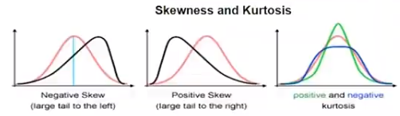
Skewness and kurtosis

Slide 58
Central limit theorem
The central limit theorem states that the mean of a sufficiently large number of identically distributed random variates will be approximately normally distributed.
The sampling distribution of the mean tends toward normality, regardless of the distribution.

Slide 59
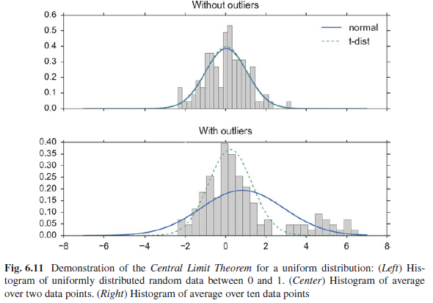
Central limit theorem

